Slide 1
Cohen chap 10. Linear Regression
“Fit the analysis to the data,
NOT the data to the analysis.”
-Statistical Maxim
For EDUC/PSY 6600

Slide 2
Motivating example
Dr. Ramsey conducts a non-experimental study to evaluate what she refers to as the ‘strength-injury hypothesis’. It states that overall body strength in elderly women determines the number and severity of accidents that cause bodily injury. If the results of her prediction study support her hypothesis, she plans to conduct an experimental study to assess whether weight training reduces injuries in elderly women.
Data from 100 women who range in age from 60 to 70 years old are collected. The women initially undergo a series of measures that assess upper and lower body strength, and these measures are summarized into an overall index of body strength.
Over the next 5 years, the women record each time they have an accident that results in a bodily injury and describe fully the extent of the injury. On the basis of these data, Dr. Ramsey calculates an overall injury index for each woman.
A simple regression analysis is conducted with the overall index of body strength as the predictor (independent) variable and the overall injury index as the outcome (dependent) variable.

Slide 3
Correlation vs. Regression
Correlation
Does a relationship exist between 2 variables?
No IV / DV distinction
How strong is relationship?
In what direction is relationship?
Regression
What is the form of relationship?
Can we predict values of one variable from knowledge of one or more, highly correlated variable(s)?
Perfect correlation = Perfect prediction
Imperfect correlation = Imperfect prediction (with error)
Simple linear regression (SLR): 1 DV, 1 IV
Multiple linear regression (MLR): 1 DV, >1 IV

Slide 4
Regression basics
Regression analysis is procedure for obtaining THE line that best fits data
(Assuming relationship is best described as linear)
Equation for straight line:
Yhat_{i} = b₀ + b₁ X_{i}
Yhat_{i} = predicted (unobserved) value of Y for a given case i
b₀ = y-intercept
Constant
Yhat when X = 0
only interpreted if X = 0 is meaningful
Alternative notation: ‘a’ or ‘a_{XY}’
b₁ = slope of regression line for 1st IV
Constant
Rate of change in Y for every 1-unit change in X
Alternative notation: ‘b_{XY}’
X_{i} = value of predictor for a given case i
Y usually predicted variable
Dependent, criterion, outcome, response variable
Predicting Y from X = ‘Regressing Y on X’
Predicting X from Y = ‘Regressing X on Y’
X usually variable used to predict Y
Independent, predictor, explanatory variable
Different results when X & Y switched
Lecture assumes DV is Y, IV is X

Slide 5
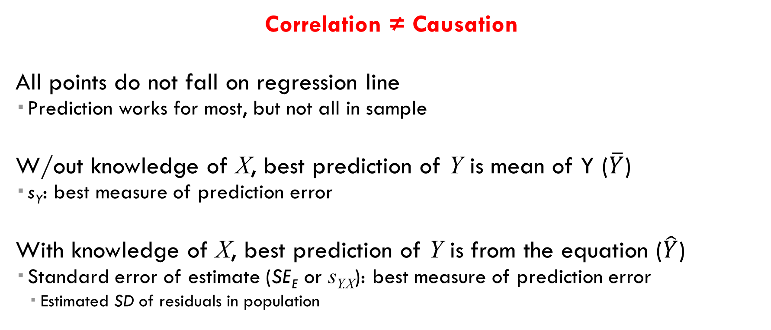
Accuracy of Prediction
Correlation ≠ Causation
All points do not fall on regression line
Prediction works for most, but not all in sample
W/out knowledge of X, best prediction of Y is mean of Y ($\overline{Y}$)
s_{Y}: best measure of prediction error
With knowledge of X, best prediction of Y is from the equation ($\hat{Y}$)
Standard error of estimate (SE_{E} or s_{Y.X}): best measure of prediction error
Estimated SD of residuals in population

Slide 6
Accuracy of prediction
s_{y.x} = standard error of estimate
s²_{y.x} = residual or error variance or mean square error
df = N – 2
2 df lost in estimating regression coefficients
Seeking smallest s_{Y.X} as it is a measure of variation of observations around regression line

Slide 7
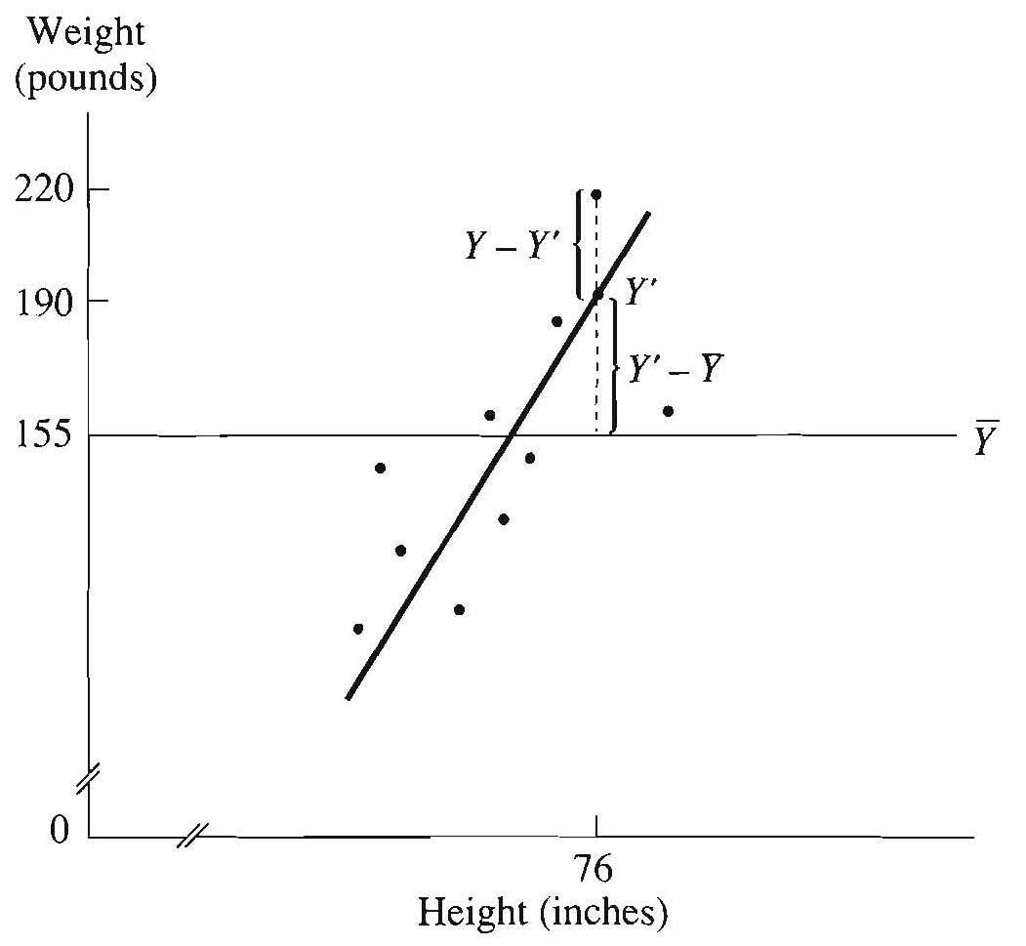
“Line of best fit”
As prediction is not usually perfect, regression coefficients (b₀, b₁) computed to minimize error as much as possible
Error or residuals: difference between observed Y and predicted Y’
e_{i} = (Y_{i} – Y’_{i})
Technique: ordinary least squares (OLS) regression
Goal: minimize SS error, i.e. SS residuals

Slide 8
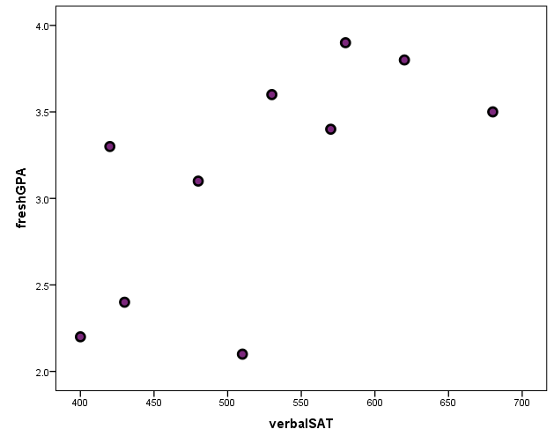
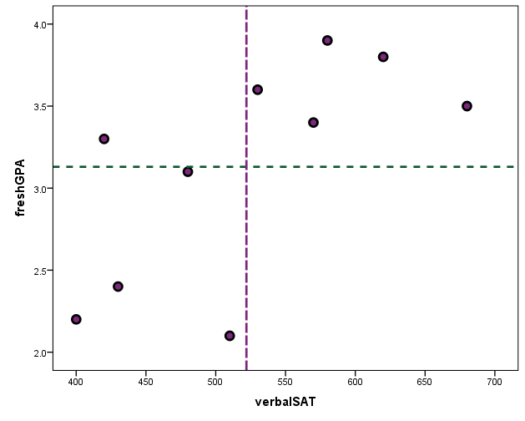
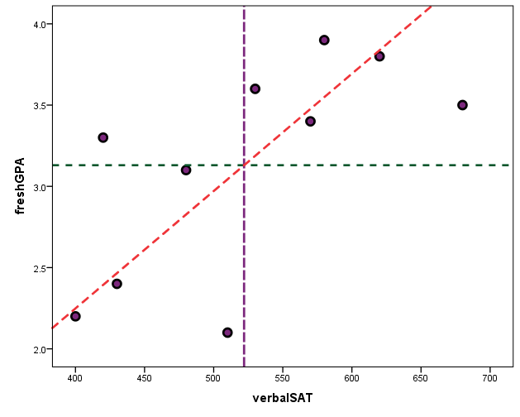
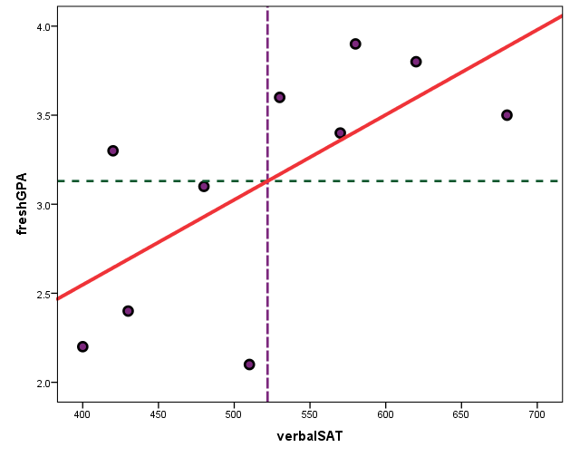

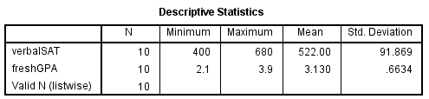





SLOPE: $b_{1}=r\frac{s_{y}}{s_{x}}= .661\frac{.66}{91.87}=0.0047$
INTERCEPT: $b_{0}=\overline{Y}−b_{1}\overline{X}=3.13−.0047∗522=0.$68
EQUATION: $\hat{Y}=0.68+0.0047∗X$
Verbal SAT | GPA
510 | 2.1
620 | 3.8
400 | 2.2
480 | 3.1
580 | 3.9
430 | 2.4
530 | 3.6
680 | 3.5
420 | 3.3
570 | 3.4
$${SS}_{explained}$$
$${SS}_{unexplained}$$
= +
$${SS}_{total}$$
(mean to the point)
(mean to the line)
(line to the point)
“Residuals”

Slide 9
Explaining variance
SS_{Total (Y)} = SS_{Regression (Y’)} + SS_{Residuals(e)}
Coefficient of determination (r²)
computed to determine how well regression equation predicts Y from X
r² = Explained variation / Total variation -OR- r² = SS_{Regression (Y’)} / SS_{Total (Y)}
Ranges from 0 to +1
If each SS was divided by its df :
Explained variance: SS_{Reg} / (1)
“Mean Square Regression” or MS_{Regression}
Unexplained variance: SS_{Res} / (N - 2)
“Mean Square Residuals” or MS_{Error} or s²_{Y.X}
Interpret r² as a percent of variance in outcome variable…
“accounted for”
“attributable to”
“predictable from”
“associated with”
“explained by”
…knowledge of predictor variable

Slide 10
Standardized Regression Coefficients
Aka: “Beta weights” or β
1 SD-unit change in X represents a β SD change in Y
Intercept = 0 and is not reported when using β
For simple regression ONLY
r = β and r² = β²
When raw scores are transformed into z-score units r = b = β
Useful for variables w/ abstract unit of measurement

Slide 11
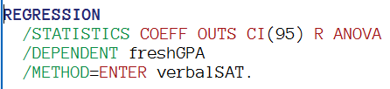
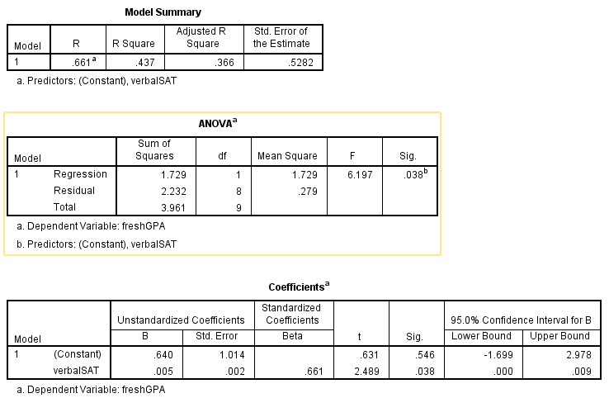
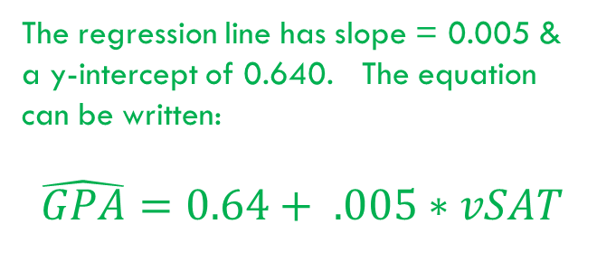
Example:
Pearson’s correlation coefficient = 0.661. This indicates there is a positive linear relationship.
Coefficient of Determination = .437. This indicates that 43.7% of the variation in GPA can be explained by verbal SAT alone.
The regression line has slope = 0.005 & a y-intercept of 0.640. The equation can be written:
$$\hat{GPA}=0.64+ .005∗vSAT$$
For each SD above the mean of verbal SAT, the same student is 0.661 SD’s above the mean of GPA, on average.
Verbal SAT is a significant predictor of GPA.

Slide 12
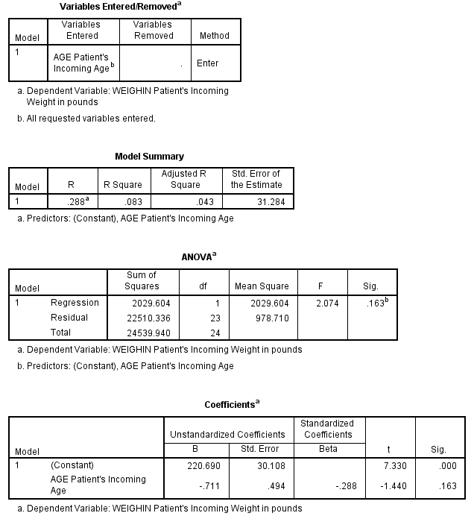
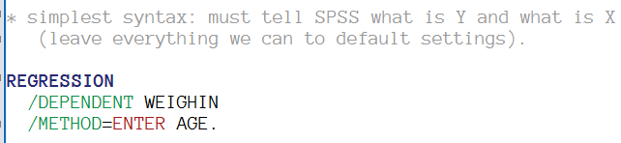
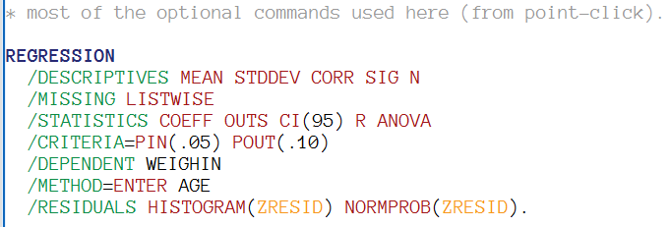
SPSS - basic

Slide 13
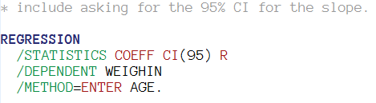
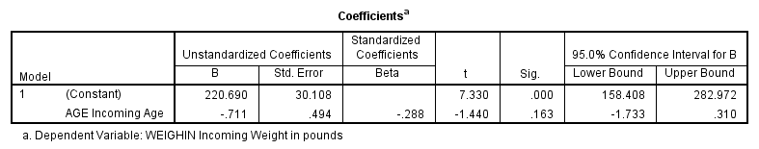
SPSS: get beta confidence intervals

Slide 14
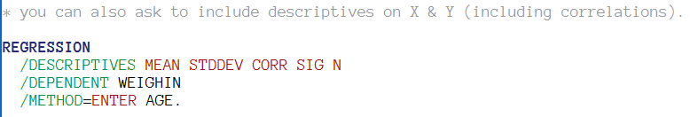
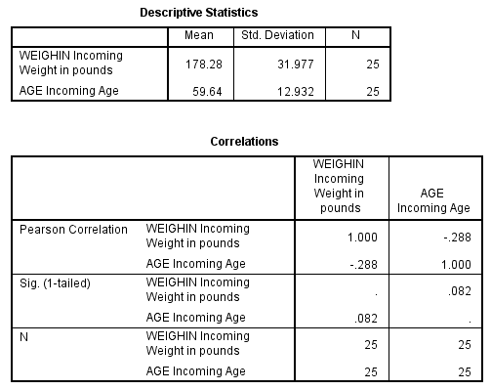
SPSS: include descriptives in the output

Slide 15
Assumptions
Independence of observations
Y normally distributed
Does NOT apply to predictor variable(s) X
Can be categorical or continuous
Sampling distribution of the slope (b₁) assumed normally distributed
Straight line best fits data

Slide 16
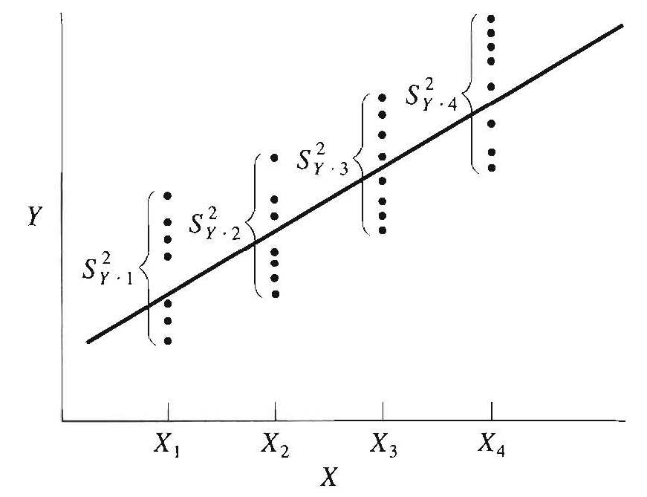
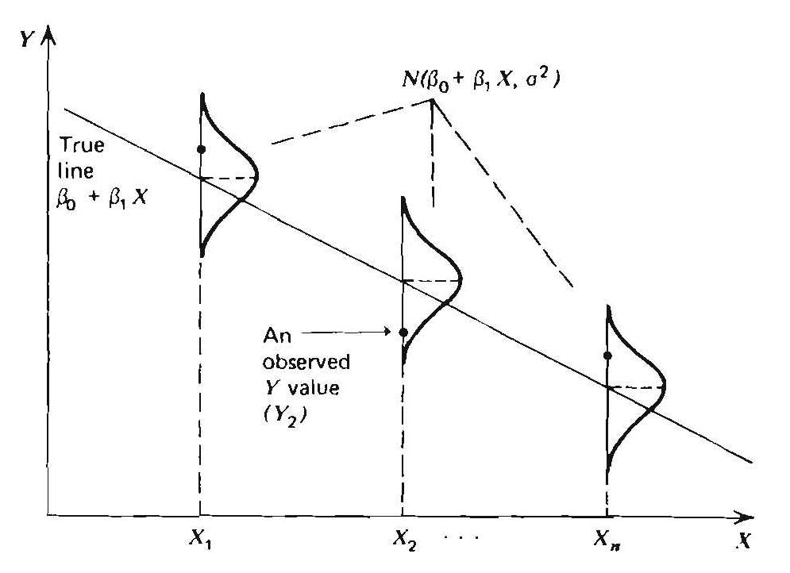
assumptions
Homogeneity of variance of Y for all values of X
Computed error variance (s²_{Y.X} or MSE) is representative of all individual conditional error variances (for each value of X)
‘Homoscedasticity’
Violation = ‘Heteroscedasticity’

Slide 17
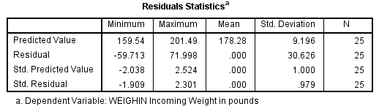
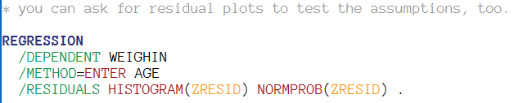
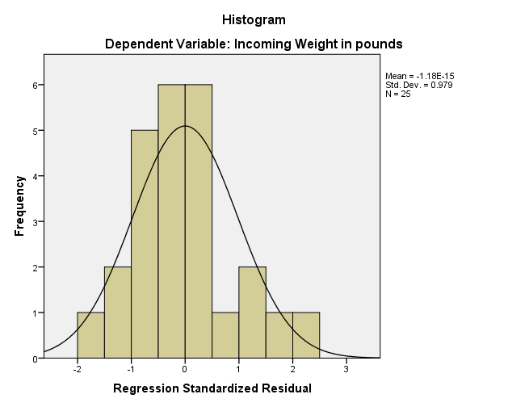
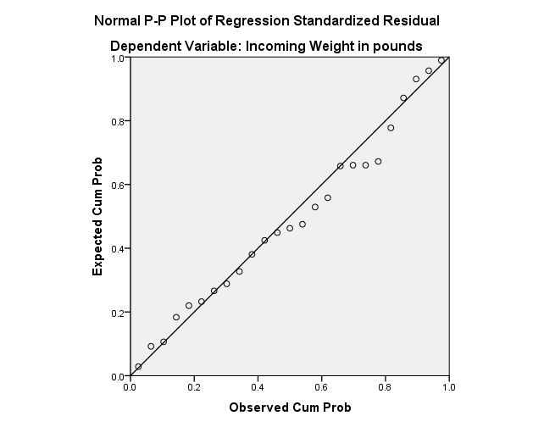
SPSS: Residual plots (test assumptions)

Slide 18
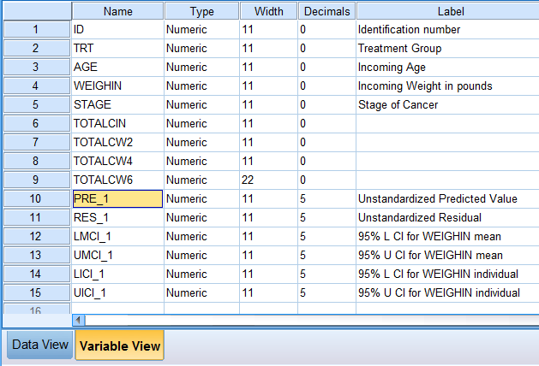

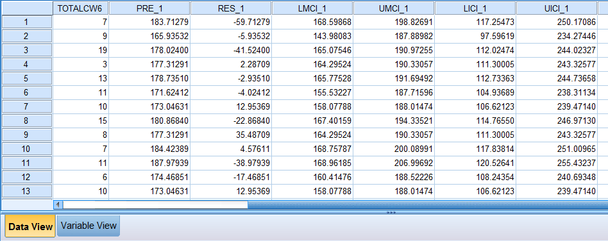
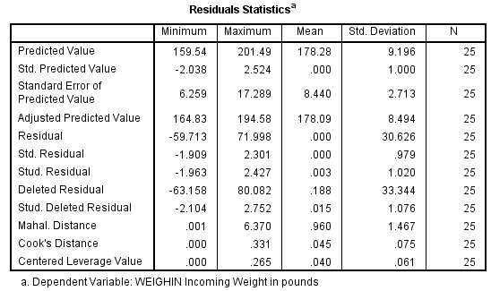
SPSS: OPTION to “SAVE”

Slide 19
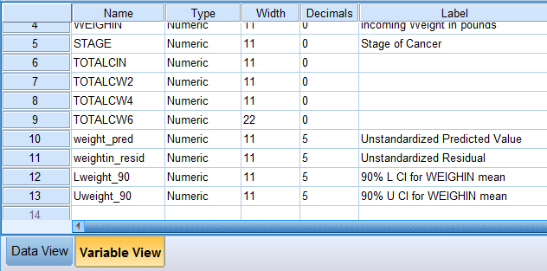
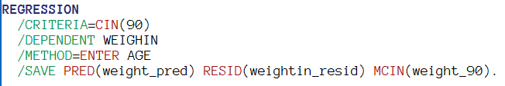
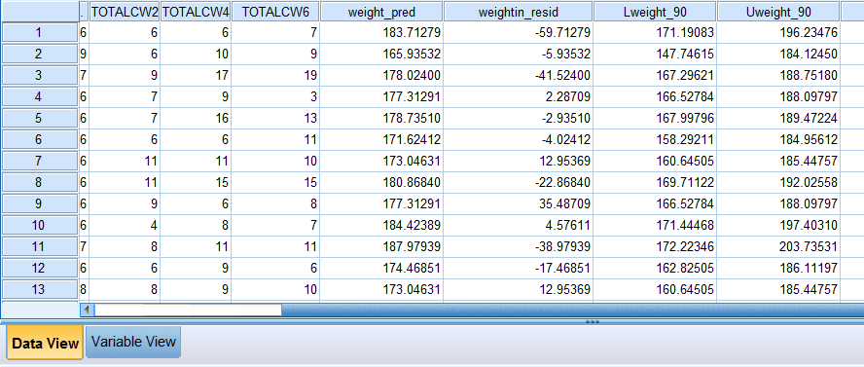
SPSS: OPTION to “SAVE”

